Slide 1

NLP-Driven Resume Screening and Intelligent Job Recommendation System
DSA0307- NATURAL LANGUAGE PROCESSING
PRESENTED BY:
Charandeep.N.C(192472196)
A.Sai Rohit (192472144)
D. Sri Anjaneya(192425219)
L. Sanjay Kumar (192425226)
K.Mounith(192425090)
GUDIED BY:
Dr.K.Anbazhagan

Slide 2


OVERVIEW
ABSTRACT
INTRODUCTION
LITERATURE SURVEY
EXISTING SYSTEM
PROBLEM IDENTIFICATION
PROPOSED SYSTEM
OBJECTIVE
ARCHITECTURE DIAGRAM
BRIEF EXPLANATION OF MODULES
IMPLEMENTATION SCREENSHOT
RESULTS
CONCLUSION & FUTURE ENHANCEMENT
REFERENCES

Slide 3


ABSTRACT
The NLP-Driven Resume Screening and Intelligent Job Recommendation System is designed to automate the process of analyzing resumes and matching candidates with suitable job opportunities. The system uses Natural Language Processing techniques to extract important information such as skills, education, and experience from resumes. It compares candidate profiles with job descriptions, calculates matching scores, and recommends the most relevant job roles. This approach reduces manual screening effort and provides faster, more personalized, and efficient job recommendations.

Slide 4
INTRODUCTION
The system uses Natural Language Processing (NLP) to automatically analyze and understand candidate resumes.
It extracts important information such as skills, education, experience, and qualifications from resumes.
The extracted information is compared with available job requirements to identify suitable opportunities.
The system recommends jobs based on how well a candidate's profile matches the required skills and experience.
This approach makes the recruitment process faster, smarter, and more personalized for both candidates and recruiters.

Slide 5
LITERATURE REVIEW
Author / Year | Method / Technique | Focus Area | Key Feature | Outcome | Relevance to Our Work
Huang et al., 2023 | Attentive Deep Neural Network + Attention Mechanism | Resume and talent recommendation | Learns hidden relationships between resumes and job preferences | Improved personalized talent recommendation | Helps us improve resume–job matching and recommendation accuracy
Kumar et al., 2024 | BERT + NLP + Web Scraping | Personalized Job Recommendation | Creates embeddings for user profiles and job descriptions | Provides relevant job recommendations based on user profiles | Supports our NLP-based job recommendation module
Gan et al., 2025 | LLM Agents + NLP + Fine-tuning | Automated Resume Screening | Summarizes, grades, and makes screening decisions from resumeS | Screening was reported as 11× faster than manual methods | Supports our automated resume screening and candidate evaluation
Gupta & Singh, 2024 | Generative AI + NLP + Web Scraping | Resume Tracking and Job Suggestions | Analyzes resumes and matches them with job descriptions | Provides personalized job suggestions and improves job-search efficiency | Directly supports our resume analysis and job recommendation system

Slide 6
EXISTING SYSTEM
Traditional resume screening mainly depends on manual review by recruiters, which takes a lot of time.
Resumes are often filtered using simple keyword matching, which may miss relevant skills.
Candidates may receive general job suggestions that are not fully personalized.
Screening a large number of resumes can lead to inconsistency and human errors.
Existing systems may not clearly identify the skill gap between a candidate and a job.

Slide 7
PROBLEM STATMENT
Manually screening a large number of resumes is time-consuming and difficult for recruiters.
Important candidate skills may sometimes be missed during traditional resume screening.
Candidates often struggle to find jobs that properly match their skills and qualifications.
Existing job matching methods may provide recommendations that are not sufficiently personalized.
Therefore, there is a need for an NLP-based system that automatically screens resumes and recommends suitable jobs accurately.

Slide 8
PROPOSED SYSTEM
The proposed system uses NLP to automatically understand and analyze resume content.
It extracts important details such as skills, education, experience, and certifications.
The candidate profile is intelligently compared with different job descriptions and requirements.
A job matching score is calculated to identify the most suitable opportunities.
The system provides personalized job recommendations and identifies missing skills to help candidates improve.

Slide 9
OBJECTIVES
The main objective of this project is to develop an NLP-based system that automatically analyzes resumes and extracts important candidate information such as skills, education, and experience.
The system compares this information with job requirements to identify suitable job opportunities. It aims to reduce the time and effort involved in manual resume screening while providing personalized and relevant job recommendations.

Slide 10


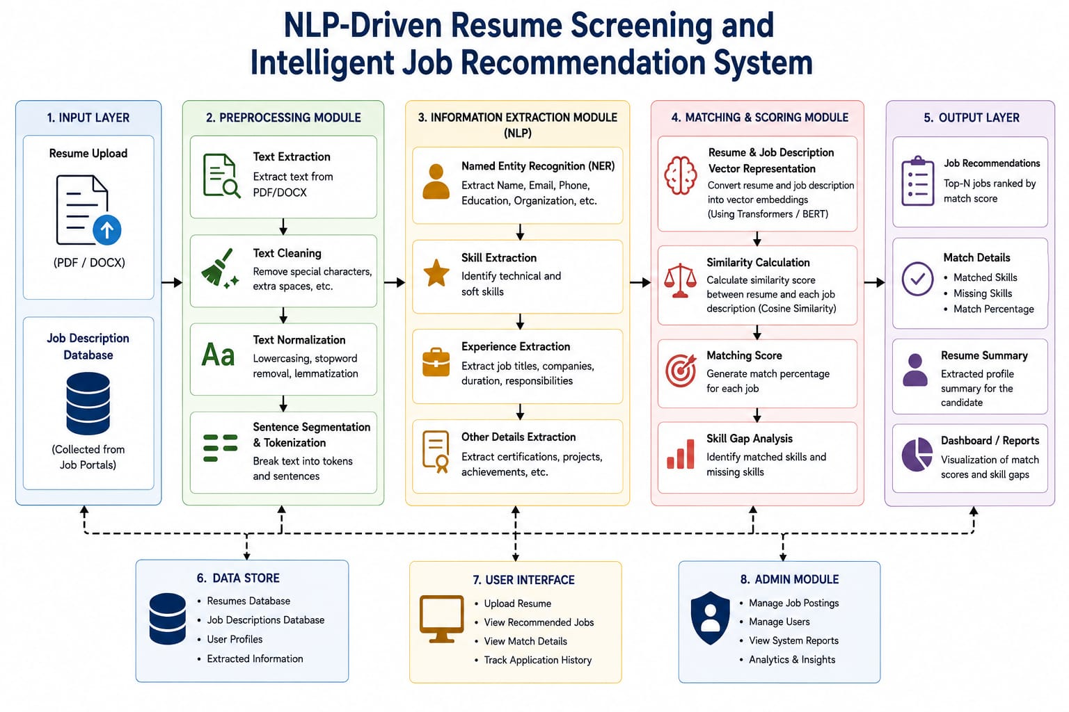
SYSTEM ARCHITECUTURE

Slide 11
Module 1 – Resume Data Collection and Preprocessing
Introduction: This module collects candidate resumes and prepares the text for accurate NLP analysis.
Working:
Uploads resumes in formats such as PDF or DOCX.
Extracts the textual content from the uploaded resume.
Removes unnecessary symbols, spaces, and irrelevant information.
Converts the resume text into a clean and structured format.
Prepares the processed data for further analysis.

Slide 12
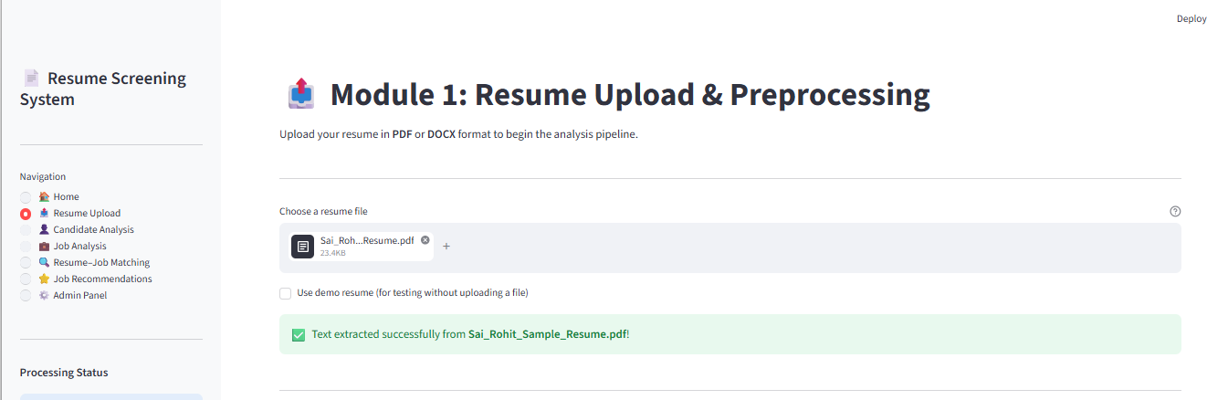
Module 1 – Output

Slide 13
Module 2 – Candidate Information and Skill Extraction
Introduction: This module uses NLP techniques to identify important information from the candidate's resume.
Working:
Extracts the candidate's name and basic details.
Identifies technical and soft skills mentioned in the resume.
Detects educational qualifications and certifications.
Extracts work experience and relevant projects.
Creates a structured candidate profile from the resume.

Slide 14
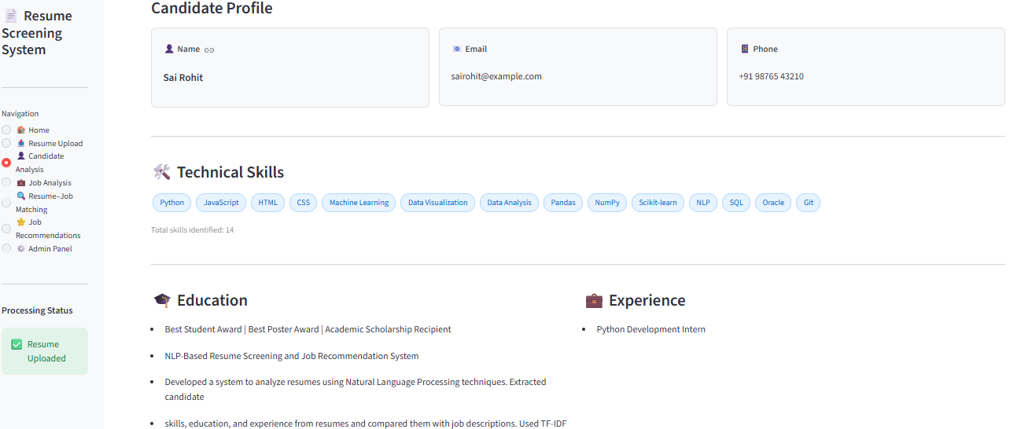
Module 2 – Output

Slide 15
Module 3 – Job Description Analysis
Introduction: This module analyzes job descriptions to understand the requirements of different job roles.
Working:
Collects job titles and job descriptions.
Extracts required technical skills and qualifications.
Identifies experience requirements for each job.
Processes job descriptions using NLP techniques.
Creates a structured job requirement profile.

Slide 16
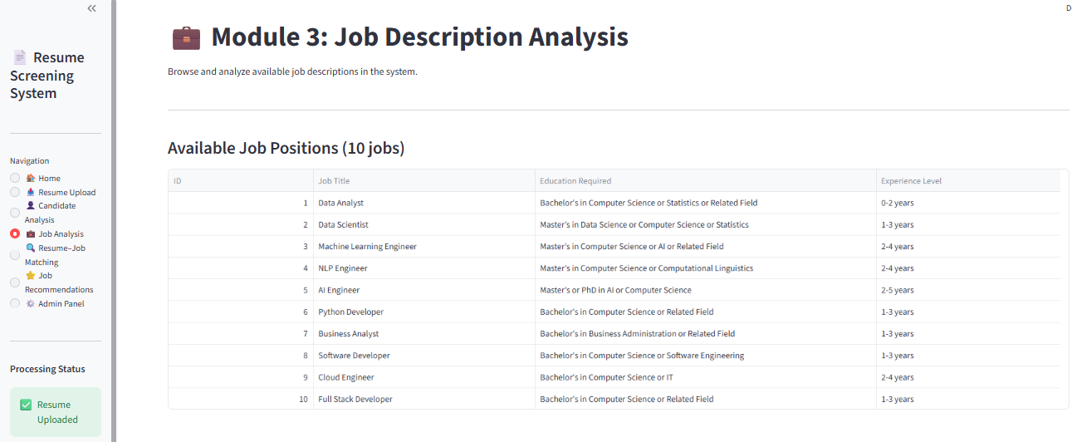
Module 3 – Output

Slide 17
Module 4 – Resume–Job Matching and Screening
Introduction: This module compares the candidate profile with job requirements to determine suitability.
Working:
Compares candidate skills with the required job skills.
Measures the similarity between the resume and job description.
Calculates a matching score for each available job.
Identifies missing or unmatched skills.
Screens and ranks candidates based on their job suitability.

Slide 18
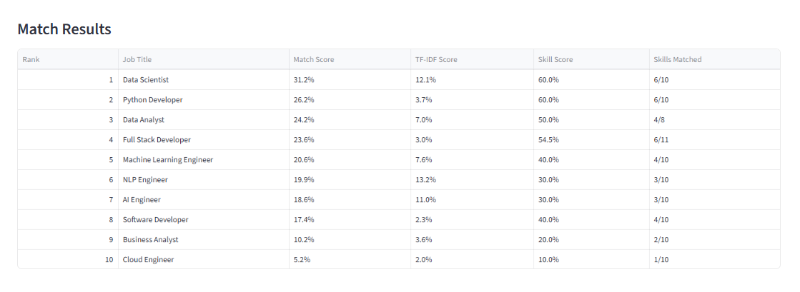
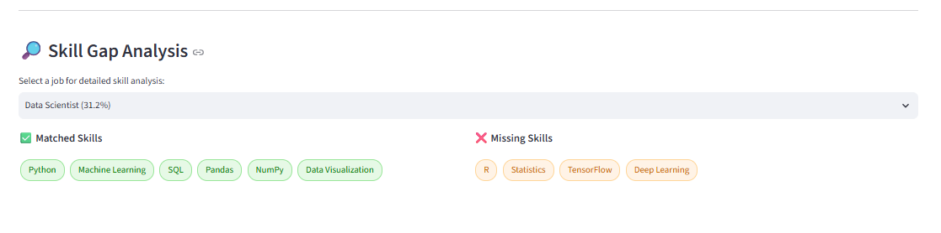
Module 4 – Output

Slide 19
Module 5 – Intelligent Job Recommendation and Results
Introduction: This module recommends the most suitable jobs based on the candidate's profile and matching results.
Working:
Ranks job opportunities based on the calculated matching score.
Recommends the most relevant job roles to the candidate.
Displays matched skills and missing skills for each job.
Provides personalized suggestions to improve job suitability.
Presents the final results through a simple and user-friendly dashboard.

Slide 20
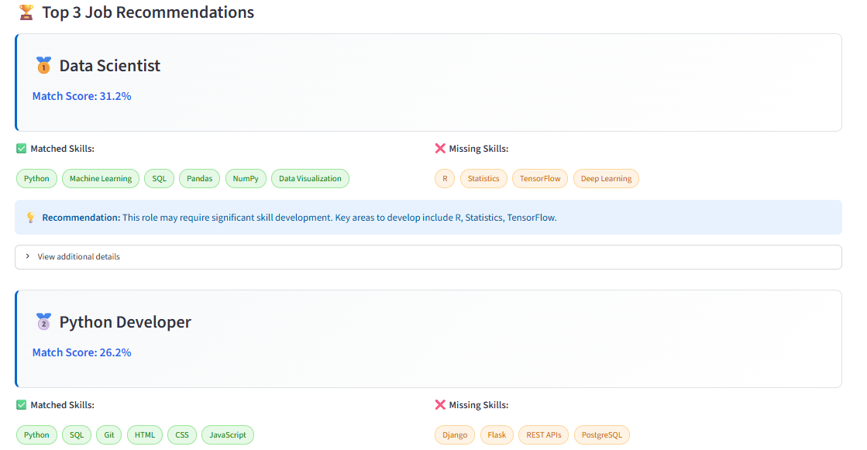
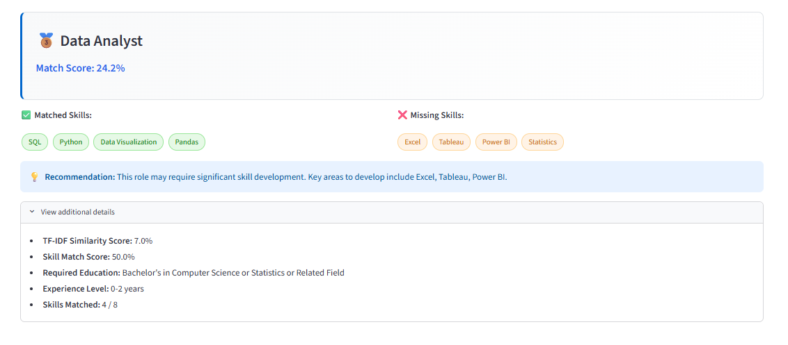
Module 5 – Output

Slide 21
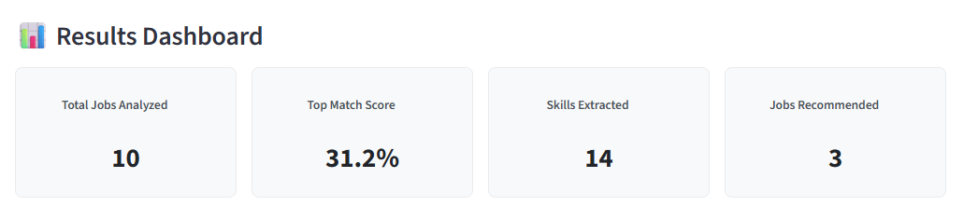
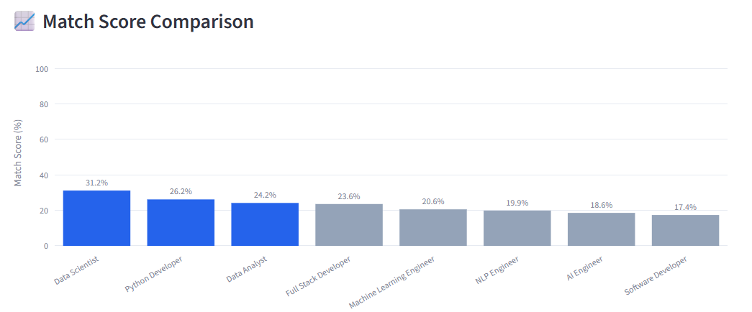
RESULTS

Slide 22
FUTURE SCOPE
The system can be improved using advanced AI and transformer models for better resume understanding.
It can be integrated with real-time job portals and APIs to provide updated job opportunities.
Future versions can include AI-based interview preparation and career guidance.
A multilingual feature can help analyze resumes and recommend jobs in different languages.
The system can also provide personalized learning recommendations to help users develop missing skills.

Slide 23
CONCLUSION
The system uses NLP to automatically analyze resumes and extract important candidate information.
It matches candidate skills, education, and experience with suitable job requirements.
It reduces the time and effort involved in manual resume screening.
The system provides personalized job recommendations based on the candidate's profile.
It also identifies skill gaps, helping candidates improve their career opportunities.

Slide 24
REFERENCES
Huang, Y., Liu, D.-R., & Lee, S.-J. (2023). Talent Recommendation Based on Attentive Deep Neural Network and Implicit Relationships of Resumes. Information Processing & Management, 60(4), 103357.
Gan, C., Zhang, Q., & Mori, T. (2024). Application of LLM Agents in Recruitment: A Novel Framework for Automated Resume Screening. Journal of Information Processing, 32, 881–893.
Iso, H., Pezeshkpour, P., Bhutani, N., & Hruschka, E. (2025). Evaluating Bias in LLMs for Job-Resume Matching: Gender, Race, and Education. NAACL 2025 Industry Track, 672–683.
Zhu, C., Hu, X., Wu, H., Qin, C., Zhu, H., & Xiong, H. (2025). Enhancing Job Recommendations with LLM-Based Resume Completion: A Behavior-Denoised Alignment Approach. Information Processing & Management, 62(6), 104261.
Yu, X., Xu, R., Xue, C., et al. (2026). ConFit v3: Improving Resume-Job Matching with LLM-Based Re-Ranking. arXiv preprint.

Slide 25
THANK YOU

